Slide 1
Project Title:
Creating a GUI for computing different norm for given Vectors/Matrixes
Name : M M Nabi Rony

Slide 2
Outline
Overview
Methodology
Results
Conclusion
References

Slide 3
Overview
A MATLAB GUI is developed.
Three types of Norms are calculated
User input vector/Matrix
Norm selection
Display Norm result
Unit Ball for Norm output.

Slide 4
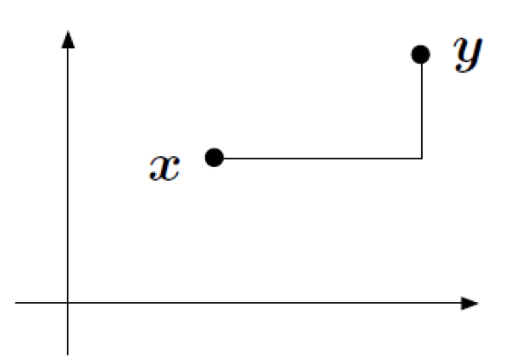


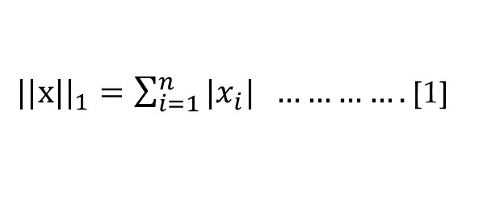
Methodology
L1 norm:
In ℝ² space [2]:
${||x||}_{1}=\sum_{i=1}^{n}{{|x}_{i}| ………….}$ [1]
Example:
x = [4 5 6];
y = [1 2 3 ]
${||x−y||}_{1}={|x_{1}−y}_{1}|$+${ |x_{2}−y}_{2}|+{ |x_{3}−y}_{3}|$
$=|4−1|$+ |5 $−$ 2$|+|6−3|$
$$=9$$

Slide 5
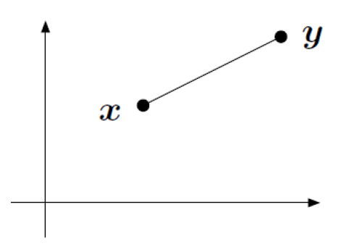
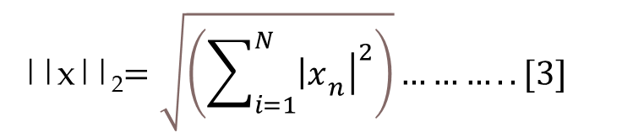
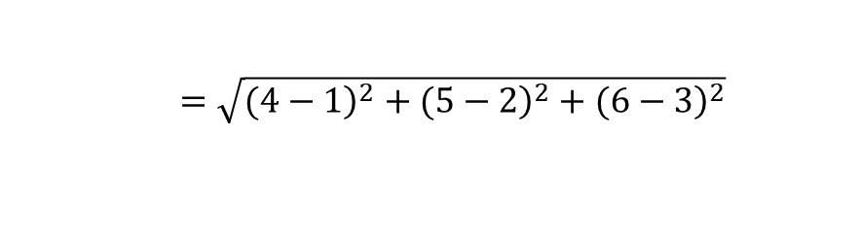
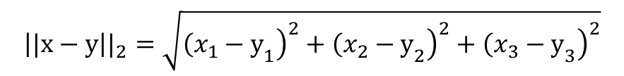
Methodology
L2 norm
In ℝ² space [2]:
||x||₂$=\sqrt{\left(\sum_{i=1}^{N}{{\left.{\left|x\right.}_{n}\right|}^{2}}\right)}………..[3]$
$${\left||x−y\right||}_{2}=\sqrt{{\left.{\left(x_{1}−y\right.}_{1}\right)}^{2}+{\left.{\left(x_{2}−y\right.}_{2}\right)}^{2}+{\left.{\left(x_{3}−y\right.}_{3}\right)}^{2}}$$
Example:
x = [4 5 6];
y = [1 2 3 ]
$=\sqrt{{\left.(4−1\right)}^{2}+{\left.(5−2\right)}^{2}+{\left.(6−3\right)}^{2}}$
$= 5.1962$

Slide 6
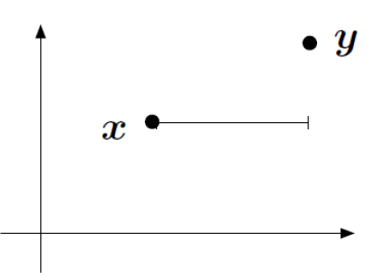

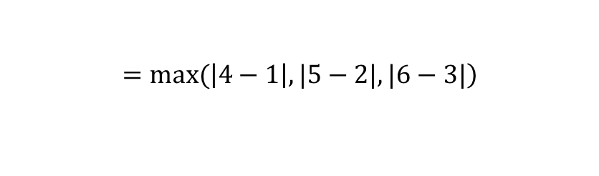
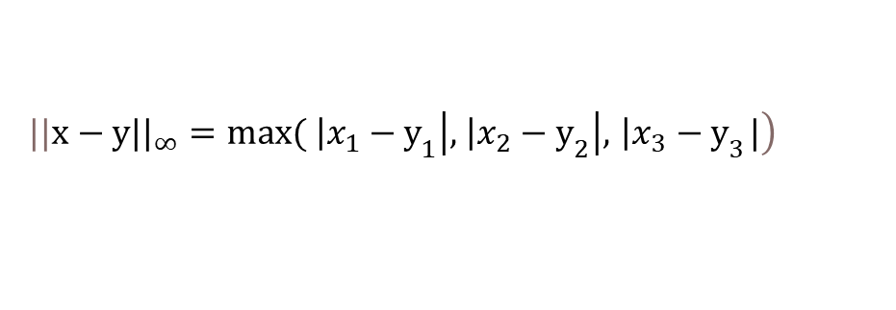
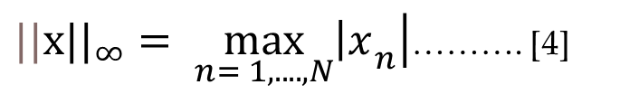
Methodology
L-inf norm
In ℝ² space [2]:
${||x||}_{∞}= \max_{n= 1,....,N}\left.{\left|x\right.}_{n}\right|$………. [4]
$$\left.{||x−y||}_{∞}=max⁡({ \left|x_{1}−y\right.}_{1}\left|,{ \left|x_{2}−y\right.}_{2}\right|,{ \left|x_{3}−y\right.}_{3}|\right)$$
Example:
x = [4 5 6];
y = [1 2 3 ]
$$\left.=max⁡(\left|4−1\right|,|5−2|, |6−3|\right)$$
$$=3$$

Slide 7
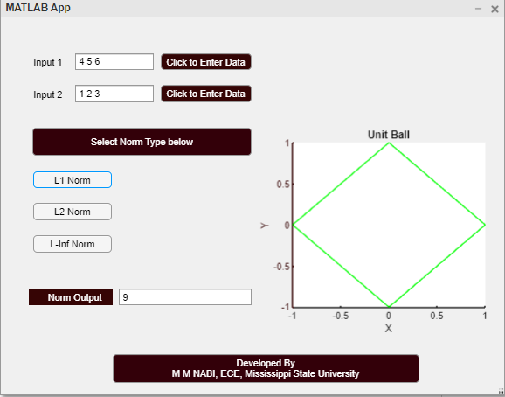
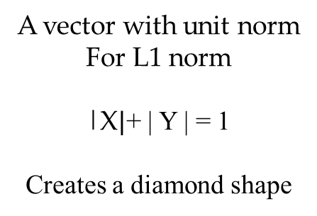
Results
L1 norm
A vector with unit norm
For L1 norm
|X$|$+ | Y | = 1
Creates a diamond shape
GUI is created in MATLAB app designer tool [5].

Slide 8
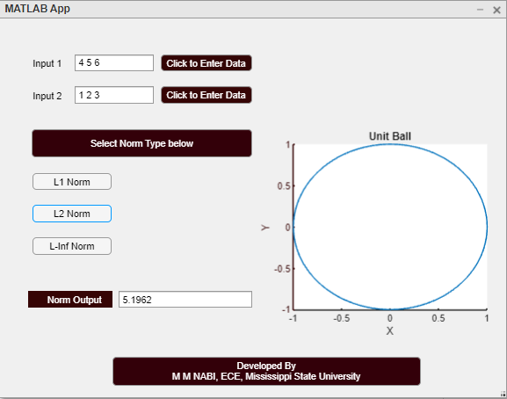
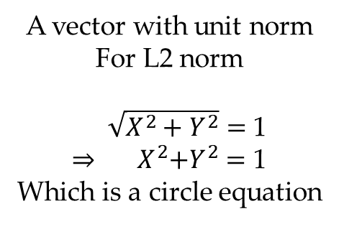
Results
L2 norm
A vector with unit norm
For L2 norm
$\sqrt{X^{2}+Y^{2}}=$ 1
⇒${ X}^{2}+Y^{2}$ $=$ 1
Which is a circle equation
GUI is created in MATLAB app designer tool [5].

Slide 9
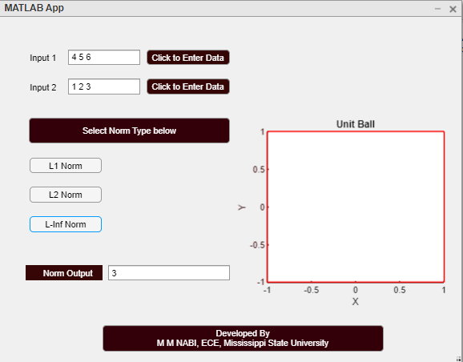
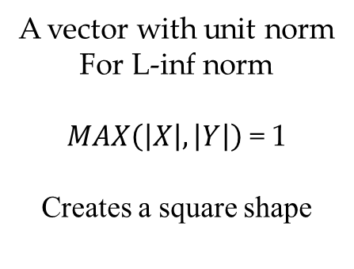
Results
L-inf norm
A vector with unit norm
For L-inf norm
$MAX\left(\left|X\right|, \left|Y\right|\right)$ = 1
Creates a square shape
GUI is created in MATLAB app designer tool [5].

Slide 10
Conclusion
Limitations-
  Cannot handle large Matrix
  Only three types of norms.
Improvement -
  Make it handle large data
  All types of norm can be analyzed.

Slide 11
References
[1] Krause, Eugene F. Taxicab geometry: An adventure in non-Euclidean geometry. Courier Corporation, 1986.
[2] Lecture Note “ECE-6990- Mathematical Foundations of Machine Learning, Spring 2021”
[3] Liberti, Leo, and Carlile Lavor. Euclidean distance geometry: an introduction. Springer, 2017.
[4] Rudin, Walter. Principles of mathematical analysis. Vol. 3. New York: McGraw-hill, 1976.
[5] Harun, Nor Hazlyna, Hamirul‘Aini Hambali, Mohamad Ghozali Hassan, and Khairah Nazurah Karim. MATLAB APP Designer: Learn By Example (UUM Press). UUM Press, 2017.

Slide 12
Thank You!
Contact:
Name: M M Nabi
Email: nabi.rony@gmail.com

